Slide 1

Bluetooth
Lesson 29

Slide 2
Wireless Communication
Earlier in the course you used code to send messages between two micro:bits
Who can remember which category the blocks are in using MakeCode?
The actual technology used to send messages between the micro:bits is Bluetooth
The micro:bit uses a special low energy version of Bluetooth so that it doesn’t overly drain the battery
This helps with the usability of the device
Notes:
Remind learners that they have already used micro:bits wirelessly. They found the blocks in the Radio category. They may not know it but this used Bluetooth to send messages between the two devices. The micro:bit uses Bluetooth low energy which maximises the battery life. Remind learners of the term ‘usability’. Usability features help to ensure that the device is as practical and easy to use as possible.

Slide 3
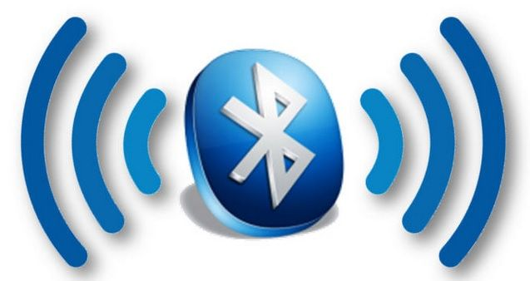
Bluetooth
Bluetooth is a type of wireless communication standard
It operates over a short distance
When Bluetooth was first released it had a range of approximately 10 metres
Newer devices using the latest version of Bluetooth can communicate up to 400 metres
Today we are going to connect your micro:bit to a mobile device
This Photo by Unknown Author is licensed under CC BY-NC
Notes:
Discuss what Bluetooth is and what a standard is. Bluetooth is a wireless communication standard which allows devices to communicate over a short distance. The latest version of Bluetooth allows devices to communicate up to a range of 400 metres. Physical objects such as walls reduce this range.

Slide 4
Installing Bluetooth into MakeCode
To use Bluetooth on the micro:bit you must install the Bluetooth library
Do this in the same way as you have installed libraries for the enviro:bit
When you choose Bluetooth you will be warned that the library is incompatible with the radio library. This is fine so click on Remove extension(s) and add bluetooth
You can only use one form of wireless communication blocks at a time on the micro:bit which is why you use either the Radio group or the Bluetooth group
Notes:
Learners should install the Bluetooth library into a new MakeCode project. When they first install it they will receive a message warning that the library is incompatible with the Radio blocks. They should just click on Ok.

Slide 5
Pairing Your Device
To allow your micro:bit to communicate with another Bluetooth device you have to pair it
This gives the devices permission to connect to each other
Once Bluetooth devices have been paired they can remember each other so that they can automatically connect in future
Notes:
Pairing a Bluetooth device involves putting both devices in pair mode and then entering a password to give them permission to communicate with each other. The way in which the devices are paired is different on different types of devices. The next slide shows how to put the micro:bit into pairing mode. You do this no matter which device you are using. There are then instructions for Android and Windows devices. If you are wishing to pair with iOS you will need to install an app on the phone / tablet. More information can be found at https://makecode.microbit.org/reference/bluetooth/bluetooth-pairing

Slide 6
Putting the micro:bit into Pairing Mode
Hold down Buttons A and B together on the micro:bit
Whilst still holding the two buttons down, press the reset button on the back of the micro:bit
Release the reset button whilst still holding Buttons A and B
You should then see ‘Pairing Mode!’ scroll across the LED screen on the micro:bit and you can then let go of the buttons
Once the message has scrolled across you will then see a pattern on the display – this may be different on different devices
Your device is then in pairing mode

Slide 7

Android and Windows
Go into settings and select Bluetooth
You should then see the device called micro:bit followed by 5 numbers in brackets.
Select the device by tapping on it
You should then see an arrow appear on the micro:bit display
On the Android phone you will be prompted to enter a PIN
On the micro:bit press Button A – you will then see a 6 digit PIN scroll across the screen
Enter these digits on the Android device and click on done
You will then see a tick on your micro:bit
The two devices are then paired
This Photo by Unknown Author is licensed under CC BY-SA

Slide 8
App
Now that you have paired your device they are able to communicate using wireless
There are a range of apps including the official micro:bit app which will allow you to send programs to the device
Notes:
There are a number of apps which learners could explore including the official micro:bit app. There are also a number of third party apps which you could explore including bitty blue. Using the actual Bluetooth library is beyond the scope of the course. More capable learners could choose an app of their own choice and then explore its use independently.

Slide 9
Wordsearch
Now that you have learned about the importance of pairing your device, how many key terms can you remember?
Check your understanding using the wordsearch

